Slide 1
A note to Quantum Neural Networks
Balas Georgios
Kofterou Maria

Slide 2
Contents
The major problems
The 5 basic approaches
Quantum Autonomous Perceptron
Quantum Feedforward Neural Networks
Quantum Associative Memory Models
Quantum Machine Learning today
Expected Advantages of QNN

Slide 3
Why a QNN?
Combines the parallel NN’s computational and learning, therefore generalization potentials, with quantum computational dynamics based on superposition
Create new unprecedented abilities in the Quantum Computing, unexpected possibilities in information processing, pattern recognition, associative memory with exponential capacity and solutions in classically intractable problems

Slide 4
3 Major Problems
Non linear activation functions Vs linearity and unitarity principles,to preserve probabilities
Dissipative nature of the deterministic NN Vs
time symmetry unitarity ensures in QS
3) Measurement

Slide 5
5 basic approaches towards a QNN:
Interpretation of the activation function as measurement
Interacting Dots
Quantum Neural Circuits
Quantum Associative Memory Models
Quantum Perceptrons

Slide 6
Interpretation of the activation function as measurement
Meneer and Nayanan:
QNN as a superposition of classical MLPs
Quantum state of the QNN =weight vector
Measurement = Pattern retrieval
Perus:
Activation of a neuron~ Green’s Function solution to Schrödinger's time evolution equation
Projection Operator G~ Hebbian Learning
Measurement = Pattern retrieval

Slide 7
Interacting Quantum Dots
Behrman et all.
Perus’ idea formulated by Feynman path integral ~ Activation of a “quron”
Time-array Neural Network of 1 two-level quron
Weights engineered by the system’s interaction with the environment
Updated based on a common backpropagation with gradient descent rule.
The physical implementation proposed: quantum dot interacting with photons
Problem:
1)Exponential system’s time evolution
2)Nonlinearity of Potential’s kinetic energy in activation function

Slide 8
Quantum Neural Circuits
Gupta and Zia:
Focused on QC perspective
QNN = Quantum Circuit
Weighted input of a neuron: Unitary operator U, enables entanglement.
Activation Function: Dissipative operator D
Problems:
D non-linear
Non properly defined (non defined for any state but |0…0>, not equality to threshold defined)

Slide 9
Quantum Associative memory Models
Hopfield NN inspired : Quantum circuit with Associative Memory
Train inputs binary encoded as qubits :Patterns to be classified
Output : state corresponding to the one pattern, among all in the memory, that is closest to the input according to Hamming distance.
A superposition of all memorized states :
Grover’s search algorithm finds the most suited state among |M>
Measurement retrieves the desired output (pattern’s state with the highest probability)
*measurement destroys superposition |M>, the construction of a number of duplicates of |M> is required.

Slide 10
Quantum Perceptrons
Altaisky:
Inspired by McCulloh-Pitts neurons, created qurons
The quantum input-to-output function:
*F not defined, non-linear
Quantum equivalent to learning rule:
*learning rule non unitary=> phase rotation,light attenuation =>System’s total probabilities not preserved
Quantum equivalent to MSE Objective Function:

Slide 11
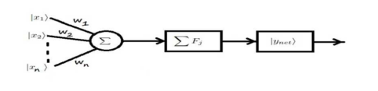
Autonomous Quantum Perceptron
Autonomous : QNN consists of 1 quron only
The model:
1 quron with n qubit inputs |x_{i}> :binary encoding of a pattern
w_{i} weight operators applied, one to each input qubit
F_{i} unique activation operators
|y_{net}> the output state of the system.

Slide 12
Autonomous Quantum Perceptron
Step 1: Set F_{i}=I, the identical matrix, all activation operators, choose randomly the initial weight operators and select a learning step h from [0,1].
Step 2: Calculate the weighted sum of the input qubits and create a superposition of all of them:
Step 3: Compare the calculated output states |y_{i}> for the patterns of each class with all the other calculated output states for the patterns of other classes.
Case A: If each |y_{i}> for any class does not equal the same value for any |y_{j}> in any other class, go to Step 5. Else, go to step 4.
Case B: If the value of any |y_{i}> =0, go to step 4. Else go to step 5.

Slide 13
Autonomous Quantum Perceptron
Step 4: Update the weight operators, set the iteration counter k=k+1 and return to Step 2.
Learning rule:
Step 5: Calculate the activation operator F_{j} for each weighted sum and return to step 2.
, where
[a_{i} b_{i}]^{T} is the weighted sum |y_{i}> qubit and [a_{di} b_{di}]^{T} the target qubit.
*F maps the weighted sum qubit to the target qubit -first row of F-
and normalizes it –second row of F-

Slide 14
Autonomous Quantum Perceptron
Step 6: Recalculate the output state as a sum of the weighted inputs again, after the application of the activation operators defined on previous step.
(**)
Step 7: One qubit among all |y_{i}> will be the response state of the Quantum Perceptron , base on the response function:
C=[1,1…1]^{T}, D is the vector of the target qubits, L a function that retains the smallest value and makes it 1 and nullify the remain values and o the Hadamard product.

Slide 15
Quantum Perceptron with Unitary Weights
Problem: F depends on θ,φ which depend on W operators =>
No reassurance that W and F are linear and unitary
Idea: Use SVD theorem and Moore- Penrose pdeudoinverses to transform F and W to unitary and also avoid iterative learning process
Vision: An autonomous quantum perceptron as a building block for a complex QNN

Slide 16
Quantum Perceptron with Unitary Weights
Step 1: Set F=I in (**), fix the learning rate and define the target states |y_{i}>
Step 2: Calculate the Moore-Penrose pseudoinverse of each input quibit |x_{i}>, that is:
Step 3: Calculate the weight operators as the tensor product of the pseudoinverse of each input and the corresponding target:
Step 4: Sum the weight operators of all inputs, with respect to their indexing, to create operator W.
Case A: If W is not unitary, move to step 5.
Case B: Else move to step 7.

Slide 17
Quantum Perceptron with Unitary Weights
Step 5: Use SVD to decompose W into three unitary matrices (see appendix), so that , U and V unitary and Σ a diagonal matrix with the singular values of W.
Step 6: Replace Σ with Σ_{new} by replacing with 1 the singular values of the diagonal and leave everything else 0.
Step 7: Introduce a measurement function:
and calculate model’s output |y_{out}> as:

Slide 18
XOR Example
XOR function returns 0 if two inputs are equal and 1 if they are not equal
XOR problem is not linear => Incomputable by classical perceptron
Class 1: P₁={|x₁>=|0>, |x₂>=|0>, |d₁>=|0>} or |x₁>=|00>
P₂={|x₁>=|1>, |x₂>=|1>, |d₂>=|0>} or |x₂>=|11>
Class 2: P₃={|x₁>=|0>, |x₂>=|1>, |d₃>=|1>} or |x₃>=|01>
P₄={|x₁>=|1>, |x₂>=|1>, |d4>=|1>} or |x₄>=|10>

Slide 19
XOR Example- Model 1
Assume a random initial weight operator
Using (**) to calculate the weighted sums we obtain:
As |y₃>=|y₄> and both these weighted sums belong to the same class, only three activation operators F will be formed.
We compute the real valued angles φ and θ for all 3 different |y> and then we create:
Calculate the superpostiton output:
No weight update is needed as the Quantum Perceptron is trained in just 1 iteration, and without using all of the training patterns!

Slide 20
XOR Example- Model 2
In the first step we calculate the pseudoinverse for each of the 4 input patterns and obtain:
Calculate all weights based on
and sum them up:
W non unitary so using SVD we obtain:

Slide 21
XOR Example- Model 2
Based on
The output is calculated in a closed form
(0 corresponds to |0> and 1 to |1>)

Slide 22

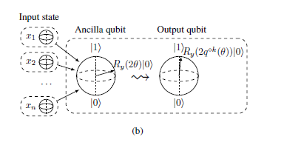
Quantum Feedforward Neural Network
Introduce ancilla qubits to encode the information of the input layer and pass it to the output layer by applying a Control Phase gate
Where,
Then, the information of ancilla qubit is channeled to output qubit through a Control Phase Rotation

Slide 23
Quantum Feedforward Neural Network
Due to quantum randomness I have to ensure that the information is properly passed to output level.
Repeat Until Success process
Measurement of ancilla qubit indicates the success or not of RUS. If it is |0> SUCCESS, if it is |1> REPEAT

Slide 24

Quantum Feedforward Neural Network
In general case of k ancilla qubits:
The final QNN’s loss function is :
In the first iteration randomly choose the weights
Use backpropagation (based on Nelder-Mead algorithm) to update weights based on the cost function
In the end of training the training accuracy is calculated

Slide 25


Quantum Feedforward Neural Network
The training accuracy of the network is defined as
Or,
With representing the best accuracy

Slide 26


Quantum Feedforward Neural Network (vol 2)
Chen and Wang proposed a QNN model consisting of several qurons:
Defining the output of the quron |y>:
Giving the possibility amplitudes of basis states as:
P(|0>)=
P(|1>)=

Slide 27


Quantum Feedforward Neural Network (vol 2)
In general case, the input layer is at state
So the activation function of the output quron is:
Where the amplitudes of basis states
And is the binary expansion vector of number i

Slide 28

Layer Transition Matrix (LTM)
The LTM corresponds the probability of layer l being in the state |k> according to the state |i> of (l-1) layer
For example for l=2
Where and
In a general case:
At this state we can define the Cost Function of the QNN as :
where OTG is the LTM of the output layer

Slide 29
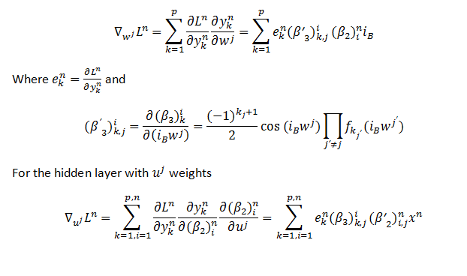

Backpropagation
The partial derivative of our loss function in output layer:
The partial derivative of our loss function in hidden layer:
The partial derivative of our loss function in generel case:

Slide 30
Control layer
Idea: create a control layer, correspond to a QRAM and store the OTG of every possible networks, n the number of control qubits
Goal: be able to generate every possible pattern corresponding to the class of the pattern that generated the output
Plus: it computes the conditional probability of the entire QNN

Slide 31
Quantum Associative Memory Models
Inspiration: Hopfield NN with associative memory and Everett’s many-world interpretation of quantum world
Idea: Instead of having a HNN trained to recognize P different classes to have P such networks, one trained to recognize one and only one class, and all of them together forming a quantum system, in superposition of all these distinct HNN’s
Instead of Hebbian Rule :
A superposition of all patterns stored:

Slide 32
Memorization
The process of storing the P train patterns to the memory of the QNN.
Goal: Create a coherent state of m basis states representing m patterns
In case of m patterns, whose binary encoding is of length n : 2n+1 qubits are required for storage
n are used to store the patterns, therefore to form the component network of the QNN’s associative memory
n+1 qubits are ancillary, used for “bookkeeping” during the storage iteration and restored to |0> after the termination of each iteration.
A polynomial number of m*n elementary operators (applied on 1,2 or 3 qubits) is needed.

Slide 33
Memorization
The key operator during this process is S^{p}, an operator that forms a set of conditional Hadamard-like transforms that will help to set the QNN in a coherent state.
Consider the case of 2 quibits required to encode a pattern, then:
p an index {1,2,…,m} indicating the pattern
There is a different operator associated to each pattern we want to store.
A different S operator is applied to the input state of the system (a basis state of n quibits that represents the pattern) in every iteration, followed by a combination n-1 CNOT and CSWAP gates, adding one pattern at a time to the coherent state of QNN.

Slide 34
Recall- Completion:
Recall the state of the pattern that corresponds better (has the closest resemblance) to a new input pattern QNN is required to classify
Grover’s quantum search algorithm is used
In the quantum computational sense, recalling a state means measure the system and cause it to collapse in that basis state that corresponds to the pattern we are searching for.

Slide 35
Recall- Completion:
An outline of the procedure is:
1)Prepare the system in |0^{n}> state.
2) Apply Hadamard gate to each input qubit, to initialize all possible states to the same amplitude.
3) Apply , an identity matrix except for i_{dd}=-1, d the desired state, to inverse its phase.
d the desired state is the one above all states in the memory that has the smallest Hamming distance to the input
4) Finally, apply , (diffusion transform) to inverse about average.
5) Repeat times and observe the system.

Slide 36
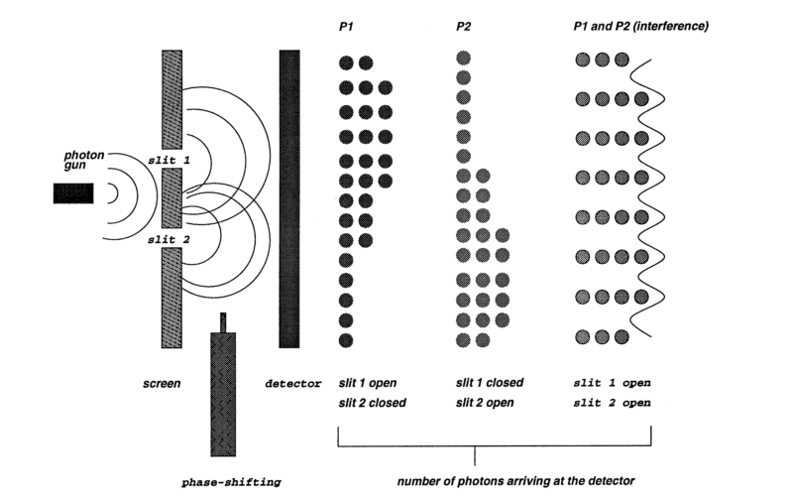
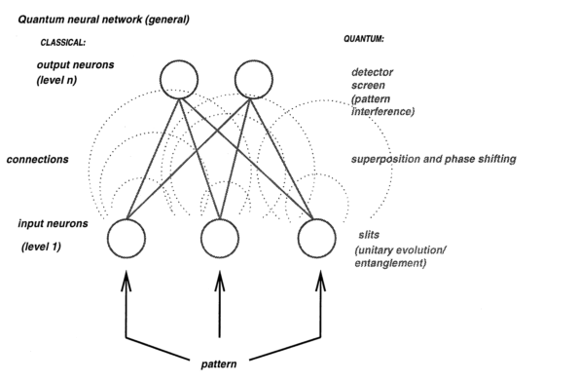
A QNN inspired by Double slit experiment
The “photon gun” is the input pattern
The slits the input neurons, in a form of entanglement
The waves between the slits created by the input patterns correspond to the connections between input and next layer’s neurons, in superposition
The output acts like a detector screen and therefore the superposition collapses when arrived in the output layer and a result is given.
In our case the output is the state obtained after a measurement.
The weight changes can be applied by a phase-shifting operator, such as the one proposed by Grover.

Slide 37
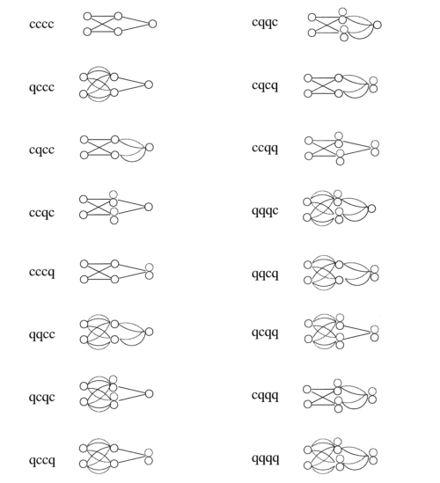
Architectures
Consider for simplicity a two layer network (input-hidden).
There are as much as 4 quantum components, namely:
1) input-to-hidden-layer (IH)
2) hidden-bias weights (HB)- the hidden neurons
3) hidden-to-output layer (HO)
4) output-bias weights (OB)-the output neurons
2⁴=16 possible architectures of QNN, ranging from completely quantum to completely classical.
Describe [IH, HB, HO, OB] a 2 layer QNN , “c”=classical component , “q” =quantum component

Slide 38
Training
1) Given m patterns for training, set m homogenous components and channel each pattern to each one of them. (Imagine each component as a classical MLP)
2) The weights of each component will be updated to learn the pattern that was channeled to it, and only this pattern.
During classical simulation, the weight update happens with classical back propagation, caused by bit-by-bit training through the input pattern.
There are as many weights in every component as the bits of the input pattern, each one be entangled with a bit.
3) Train the components as a set of classical networks which will be set in superposition after their training.
The weights from the same component are entangled with each other.

Slide 39
Training
4) The links of the QNN (links between neuron components of one layer to these of the other) are constructed based on the weights of each component as follows;
every link is a superposition of the weights taken from a different component
5) When a test input is presented, the QNN collapses to a set of weights that corresponds to the component trained to recognize the pattern closest (by hamming distance) to the test input.
Since the weights of each component are entangled, when one of QNN’s link’s superposition collapses to the state of a weight from this given component, all the other link superpositions in the QNN will collapse in the same component too.

Slide 40
Test= Collapse
Given a test input, the QNN will search for match by examining the test bit-by-bit with all the training inputs stored in its components.
1) The weights of each component are assigned coefficients, corresponding to their amplitude. The coefficient for a given weight is:
If a bit’s match is found, the phase of the appropriate weight is rotated to make it stand out, when the phases of the remaining weights remains the same.
2) After all test input’s bits are one-by-one tested, the weight coefficients are summed for each component and the measurement causes the system to collapse to the component with the greatest sum

Slide 41
Quantum Learning
Basic Definitions:
Quantum Machine Learning
Quantum algorithms
Quantum speedup
Quantum Simulators
Query Complexity
Gate Complexity

Slide 42
Quantum Learning
QML algorithms developed so far:
Linear-algrebra problems: Harrow, Hassidim and Loyd algorithm
Quantum Support Vector Machines and Quantum Radial Basis Functions
QPCA
Deep learning by training quantum Boltzmann Machines
Optimization via qBLAS- based optimization
Major Problems to QML:
The input problem
The output problem
The costing problem
The benchmarking problem

Slide 43
Expected Advantages of QNN
1) Exponential Memory capacity
2) Higher performance with lower complexity (less number of neurons, less required training data)
3) Faster learning (due to superposition)
4) Elimination of spurious or erased memory duo the absence of pattern interference
5) Solution to linear inseparable problems with only one layer QNN
6) Absence of wiring (thanks to entanglement property)
7) Higher stability and reliability
8) Processing speed (10¹⁰bits/s)
9) Small scale (10¹¹ neurons/mm³)

Slide 44
Bibliography
[1] S. C. Kak, “Quantum Neural Computing,” Adv. Imaging Electron Phys., vol. 94, no. C, pp. 259–313, 1995.
[2] M. Schuld, I. Sinayskiy, and F. Petruccione, “The quest for a Quantum Neural Network,” Quantum Inf. Process., vol. 13, no. 11, pp. 2567–2586, 2014.
[3] M. Perus, “Neural networks as a basis for quantum associative networks,” Neural Netw. World, vol. 10, no. 6, pp. 1001–1013, 2000.
[4] E. C. Behrman, L. R. Nash, J. E. Steck, V. G. Chandrashekar, and S. R. Skinner, “Simulations of quantum neural networks,” Inf. Sci. (Ny)., vol. 128, no. 3, pp. 257–269, 2000.
[5] S. Gupta and R. K. P. Zia, “Quantum Neural Networks,” J. Comput. Syst. Sci., vol. 63, no. 3, pp. 355–383, Nov. 2001.
[6] D. Ventura and T. Martinez, “Initializing the amplitude distribution of a quantum state,” Found. Phys. Lett., vol. 12, no. 6, pp. 547–559, 1999.
[7] A. A. Ezhov and D. Ventura, “. Quantum Neural Networks,” Futur. Dir. Intell. Syst. Inf. Sci. Futur. Speech Image Technol. Brain Comput. WWW, Bioinforma., p. 213, 2000.
[8] M. V. Altaisky, “Quantum neural network,” no. 1, pp. 1–4, 2001.
[9] A. Sagheer and M. Zidan, “Autonomous Quantum Perceptron Neural Network,” no. December, 2013.
[10] K.-L. Seow, E. Behrman, and J. Steck, “Efficient learning algorithm for quantum perceptron unitary weights,” pp. 1–10, 2015.
[11] J. Chen, L. Wang, and E. Charbon, “A quantum-implementable neural network model,” Quantum Inf. Process., vol. 16, no. 10, pp. 1–24, 2017.
[12] M. DePorter, Bobbi & Hernacki, “Quantum Learning,” vol. 4, no. July 1995, p. 152, 2002.
[13] A. Narayanan and T. Menneer, “Quantum artificial neural network architectures and components,” Inf. Sci. (Ny)., vol. 128, no. 3, pp. 231–255, 2000.
[14] S. S. Haykin, Neural networks and learning machines, 3rd Edition. 2009.
[15] Y. Cao, G. G. Guerreschi, and A. Aspuru-Guzik, “Quantum Neuron: an elementary building block for machine learning on quantum computers,” pp. 1–30, 2017.

